Slide 1
Sector Performance vs. Market Benchmark
Technology Sector vs S&P 500
Will Brett, Andrew Brysh, Dillon Foord

Slide 2
Agenda
SESSION
Introduction
Historical adjusted closing prices comparison
Cumulative Returns comparison
Rolling Annual Returns comparison
Volatility comparison
Technology Sector Beta relative to S&P 500
Implications
Limitations
Conclusion

Slide 3
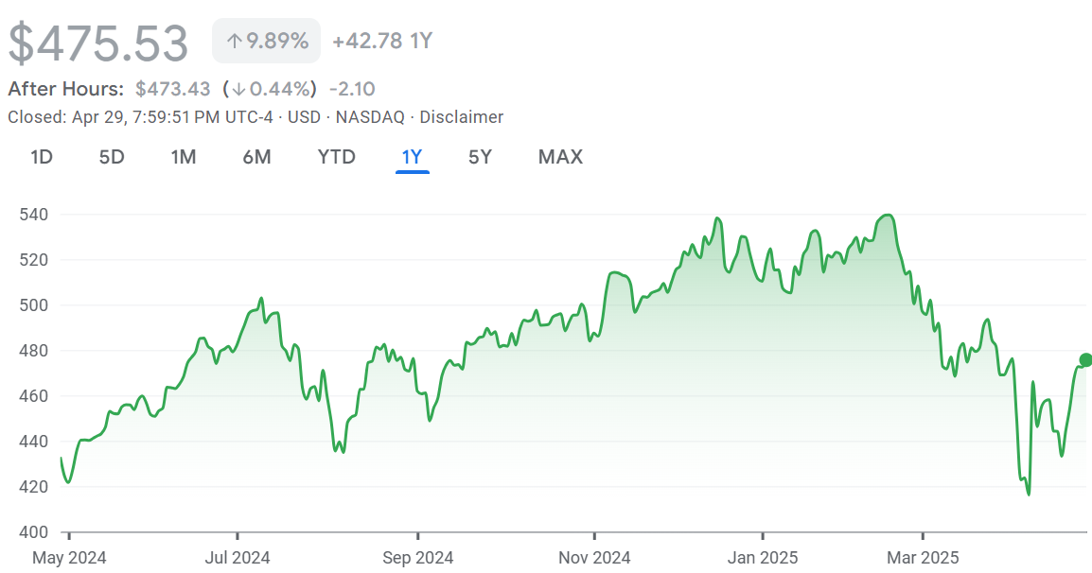
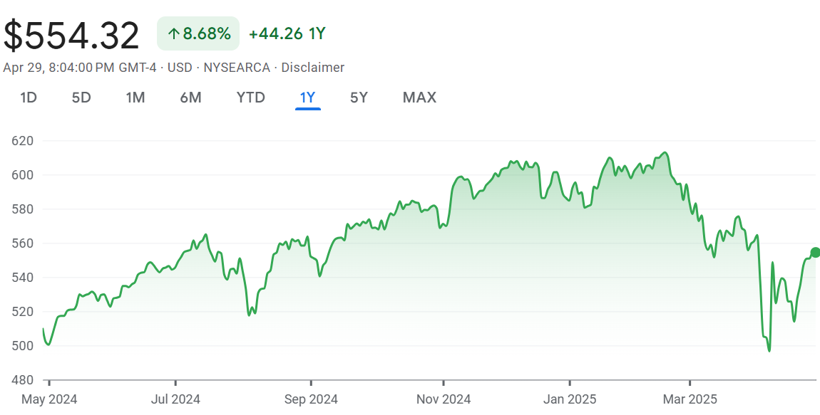
Introduction
Invesco QQQ Trust, Series 1
Technology Sector ETF
S&P 500
Broader Market

Slide 4
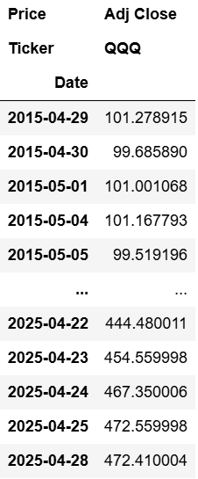
Historical Adjusted Closing Prices - QQQ
From April 29, 2015 to April 28, 2025:
Adjusted Closing price of QQQ increased by roughly 466%

Slide 5
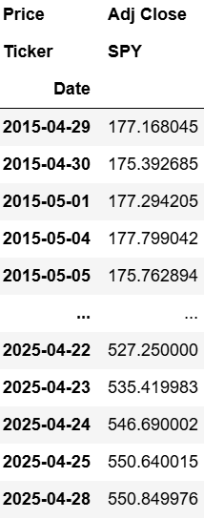
Historical Adjusted Closing Prices - SPY
From April 29, 2015 to April 28, 2025:
Adjusted Closing price of SPY increased by roughly 311%

Slide 6
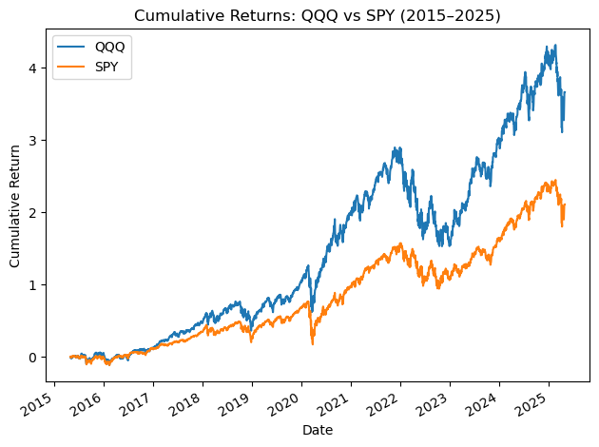
Cumulative Returns for QQQ and SPY
QQQ’s cumulative returns far outpaced SPY, notice 2019 to 2021
Technology stocks benefitted from pandemic-driven demand for digital services
At its peak, QQQ reached 4 times its starting value
At its peak, SPY reached about 2.5 times times its starting value

Slide 7
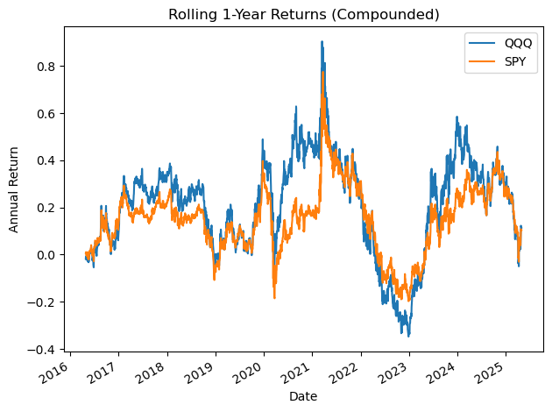
Rolling Annual Returns for QQQ and SPY
QQQ’s upside was greater during bull markets
QQQ’s drawdowns were more severe during downturns
This highlights the higher risk profile of the technology sector in comparison to the SPY

Slide 8
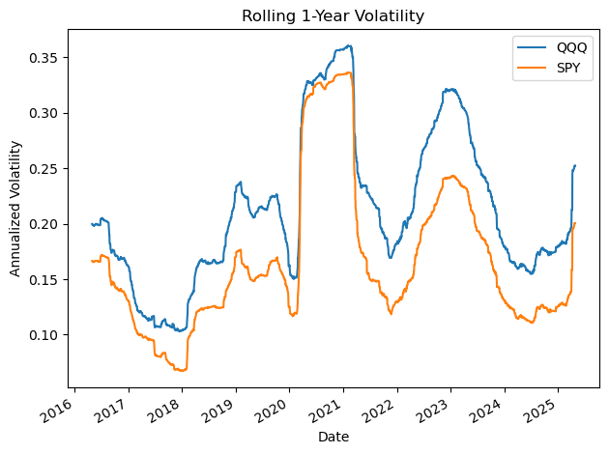
Rolling Annual Volatility for QQQ and SPY
The downside of QQQ’s outperformance of SPY has come with greater volatility
QQQ’s volatility is consistently higher than SPY
This is emphasized during periods of market stress
Most notably the 2020 pandemic selloff and the 2022-2023 correction

Slide 9
Technology Sector Beta relative to S&P 500
Calculated Beta of QQQ relative to SPY: 1.1534
Indicates that QQQ is more responsive to market movements than SPY
2020 to 2021 saw QQQ’s annual returns and volatility surge to historic highs
Reflects the sector’s exposure to the benefits and risks of rapid innovation and volatile economic conditions
More recently, the gap between QQQ and SPY narrowed due to rising interest rates and shifting market sentiment

Slide 10
Implications
Strategic Portfolio Allocation
Investors might consider overweighting technology for higher long-term returns
Risk-Return Tradeoff
The higher Beta (1.1534) indicates amplified gains but also steeper losses – QQQ better suited for risk-tolerant allocations
Economic Sensitivity and Interest Rate Risk
Recent narrowing performance gap indicates technology’s vulnerability to macroeconomic shifts like rising interest rates
Need for diversification
Smooth out risk for more conservative investors or those nearing retirement – blending sector ETFs reduces drawdowns
Further Research
Value in exploring multi-factor models or macroeconomic overlays to better attribute performance and manage risk

Slide 11
Limitations
Our analysis is based on historical price data, so it may not fully capture impact of dividends or changes in index composition
Our study does not address survivorship bias or macroeconomic factors that could explain shifts in volatility or returns
Future research could incorporate other sector ETFs, analyze impact of economic variables, or apply multi-risk factor models

Slide 12
Conclusions
Technology sector delivered superior returns relative to the broader market over the past decade
Important to factor in significantly higher volatility and risk
Investors should balance the potential for outsized gains against the likelihood of larger drawdowns, especially during market turbulence
Greater allocations to technology can enhance long-term portfolio growth, but only with full awareness of risks
QQQ serves well for risk-tolerant investors, but for others, a more balances and diversified approach might be more suitable

